Slide 1
LRU (Least Recently Used) Page Replacement Algorithm
TEAM No: 14
Team Members:
2510030179 – Ch Hymavathy
2510030404 – Jyoshna Surya Sri
2510030316 – A Rajeshwari
2510030397 – R Jashwitha
Supervisor : Dr. Alluri Seenu sir

Slide 2
Problem
Statement
To design and implement an LRU (Least Recently Used) Page Replacement system that efficiently manages memory by identifying and replacing the page that has been least recently accessed, thereby reducing page faults and improving memory utilization.

Slide 3
Introduction
LRU stands for Least Recently Used. It is a page replacement algorithm used in Operating Systems when the main memory is full. LRU replaces the page that has not been used for the longest time. The main aim of the LRU algorithm is to reduce page faults and improve memory utilization.

Slide 4
Objective
To understand page replacement in Operating Systems.
To implement the LRU (Least Recently Used) algorithm.
To identify page hits and page faults.
To reduce the number of page faults.
To improve memory management.

Slide 5
LRU Working
1.Take the reference string as input.
2.Set the number of available memory frames.
3.Check whether the requested page is already present in memory.
4.If the page is present, it is a Page Hit.
5.If the page is not present, it is a Page Fault.
6.If an empty frame is available, insert the new page.
7.If all frames are full, find the Least Recently Used
(LRU) page.
8.Replace the LRU page with the new page.
9.Continue the same process until all pages in the reference
string are completed.
10.Display the total number of page hits and page faults.

Slide 6
Algorithm
Start
Enter the reference string.
Enter the number of available frames.
Initialize all frames as empty.
Read each page from the reference string.
Check whether the page is already present in a frame.
If the page is present:
  Mark it as a Page Hit.
  Update its recent-use information.
If the page is not present:
  Mark it as a Page Fault.
If an empty frame is available:
  Insert the new page into the empty frame.
If all frames are full:
Find the least recently used page.
Replace that page with the new page.
Continue until all pages in the reference string are processed.
Calculate the total Page Hits and Page Faults.
Display the final frames and results.
Stop.

Slide 7
LRU Flowchart
start
Enter Reference String
Enter Number of Frames
Is page present?
YES
PAGE HIT
NO PAGE FAULT
Update Recent Usage
Empty Frame
Available?
Find and Replace LRU Page
Insert New Page
Process Next Page / END

Slide 8
Sample example
Sample Input
Reference string: 1 2 3 1 4
Number of frames: 3
Step-by-step LRU Working
Final Result
Total Page Hits = 1
Total Page Faults = 7
Page | Result | Frames
1 | Page Fault | 1 - - , 1 is not in memory so, insert
2 | Page Fault | 1 2 - , 2 is not in memory so, insert
3 | Page Fault | 1 2 3 , 3 is not in memory so insert
1 | Page Hit | 1 2 3 , 1 is LRU so replace with 1
4 | Page Fault | 1 4 3 ,2 is LRU so replace with 4

Slide 9
Test Case
Test Case 1 — Page Hit + LRU Replacement
Input:
Number of pages: 4
Reference string: 1 2 3 1
Number of frames: 3
Output:
Page Hit = 1
Page Fault = 3
Page | Result | Frames
1 | Fault | 1 - -
2 | Fault | 1 2 -
3 | Fault | 1 2 3
1 | Hit | 1 2 3
Test Case 2 – All Different pages
Input:
Number of pages: 4
Reference string: 1 2 3 4
Number of frames: 2
Every requested page is initially absent, so all four are Page Fault
Output: Page Hit = 0 , Page Fault = 4

Slide 10
Advantages and Disadvantages
Advantages
Disadvantages
Simple and easy to understand.
Uses recent page usage history.
Can reduce page faults.
Gives better performance than some basic methods.
Makes efficient use of limited memory.
Requires tracking of page usage.
Needs additional memory and processing time.
More complex to implement than FIFO.
Exact LRU tracking can add overhead.

Slide 11
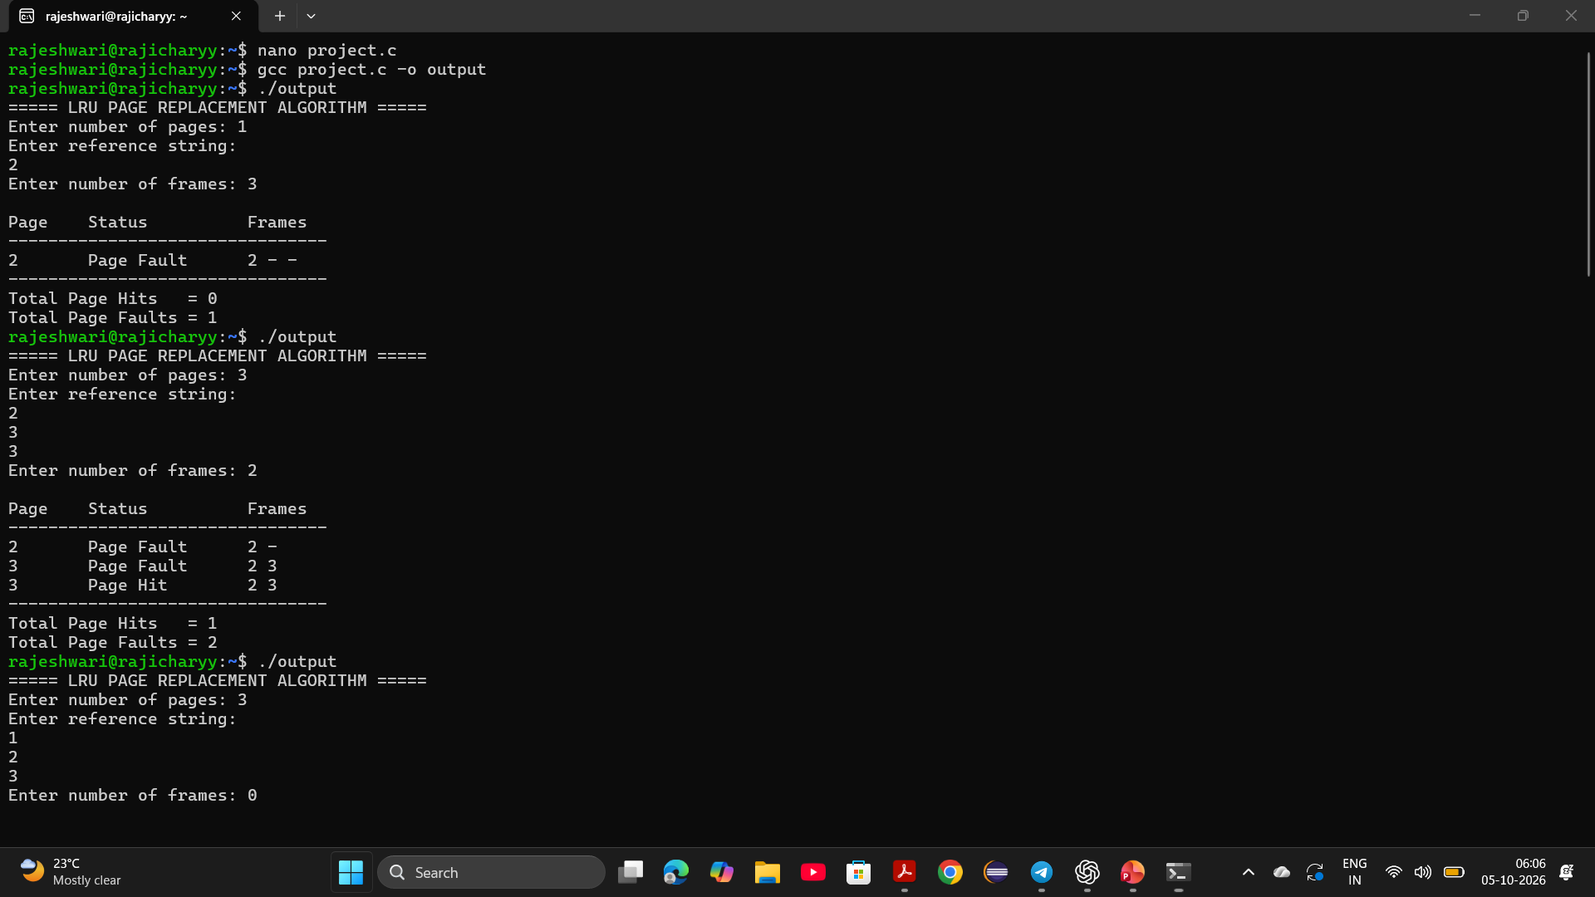
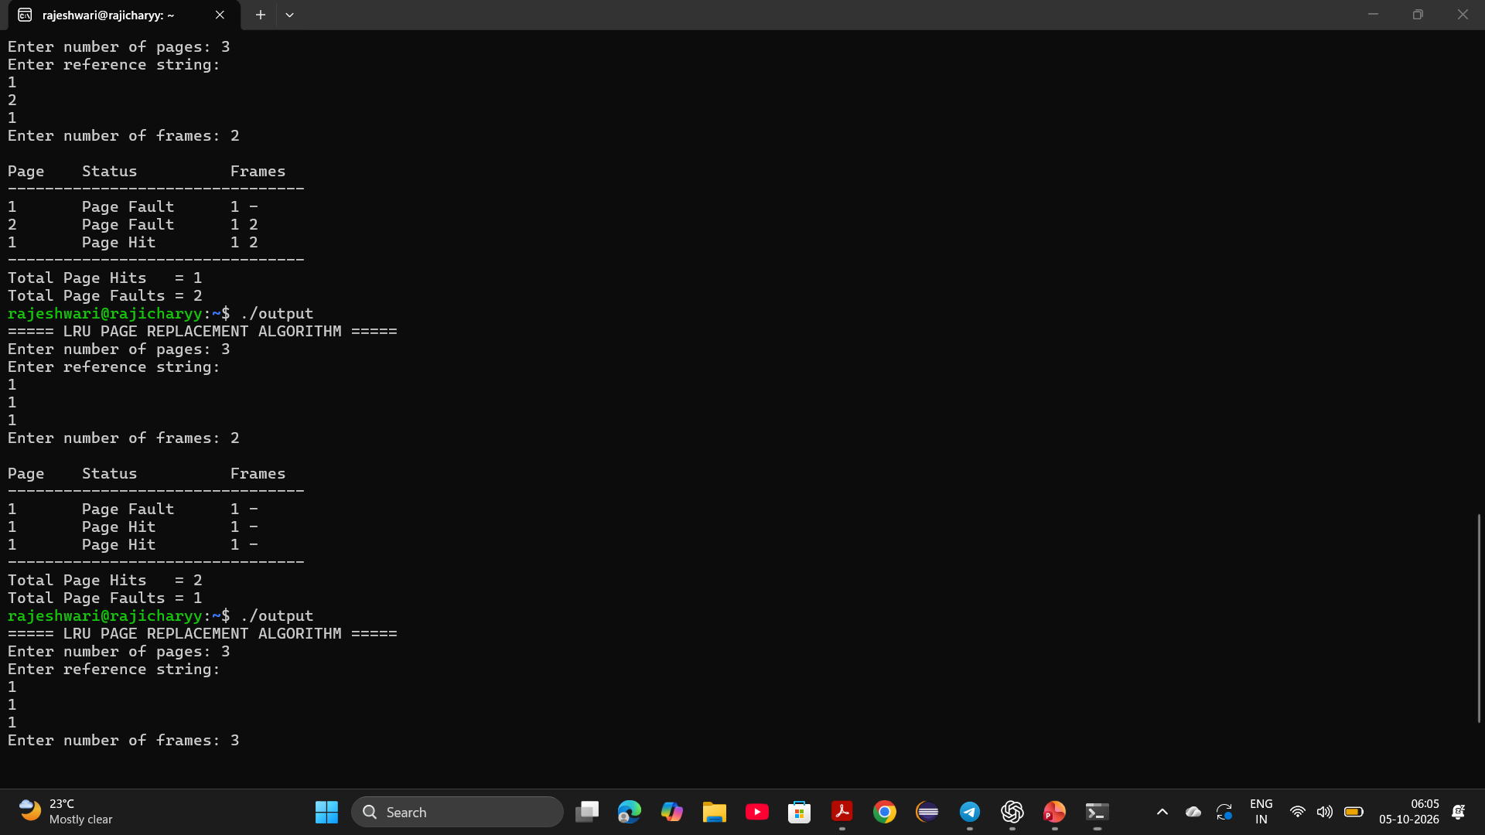
Outputs

Slide 12
Conclusion
LRU stands for Least Recently Used.
It replaces the page that has been used least recently.
It helps manage limited memory efficiently.
The program identifies page hit and page fault.
We implemented and tested the LRU algorithm using C language in Ubuntu.
Our test results demonstrate how LRU works with different reference strings

Slide 13
Thank You

